Slide 1
P2P Data Leakage (Registry and File Directory)
Malcolm Hayward
University of Baltimore
Forensic Science – Cyber Investigations

Slide 2
Objectives
What are torrent clients?
Learn how to mount the disk image.
Extract the registry files from the system.
Analyze the registry files to determine:
What was its timezone setting?
What is the OS?
What are the user accounts?
Who was the last user to logon?
When was the computer last shut down?
Acquire a listing of all files on Kamryn’s system.

Slide 3
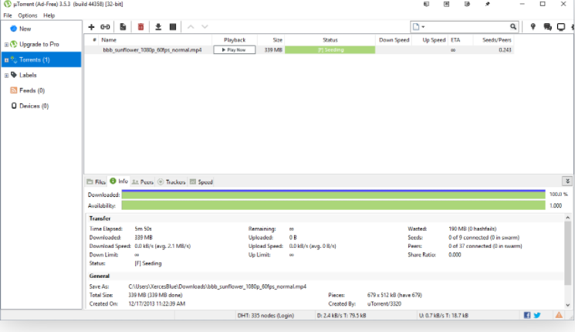
What is a Torrent client?
Torrent client is a software for downloading files that utilize a peer to peer system.
allows you to find the files, download them more quickly, and manage them all in one accessible place.
Some popular torrent applications:
uTorrent
qBittorrent
Transmission
Vuze

Slide 4
What are torrent files?
Torrent clients use torrent files to manage downloads
These files contain metadata of a file
metadata describes what files a client is trying to download
e.g., the movie you want to watch
Torrent clients can
view torrent files
create a torrent file
search for torrent files
Notes:
This is a very basic explanation. I want to go more in-depth when these files are being investigated.

Slide 5
A simple scenario
John creates a torrent file called ‘example.mp3.torrent’.
The file he created it from was called ‘example.mp3’.
‘example.mp3.torrent’ contains metadata of ‘example.mp3’.
When the download completes for ‘example.mp3.torrent’, you will have ‘example.mp3’ on your system.

Slide 6
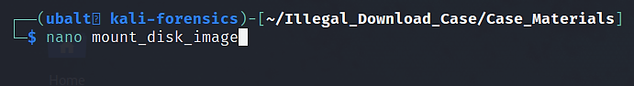
Mount the disk image
To mount the disk image, use the losetup command. For this task, we will create a script. When executed, the script will mount the disk image.
Nano is a text editor within the terminal. With this command, we are editing a new file titled ‘mount_disk_image’, which we will make into a bash script.
Alternatively, you can use Vim/NeoVim if you are familiar with this program (only recommended for advanced users).

Slide 7
How to use echo, losetup, and chmod
Echo prints the characters you type in.
Try this command: echo ‘Hello world!’
Hello world! should be printed below this command.
losetup will mount the disk image as a device on the system.
chmod modifies the file permissions.
By using the argument +x, we can make a file executable.
We will do this in the next slide to make the script executable.
Notes:
Feel free to revise the losetup explanation.

Slide 8
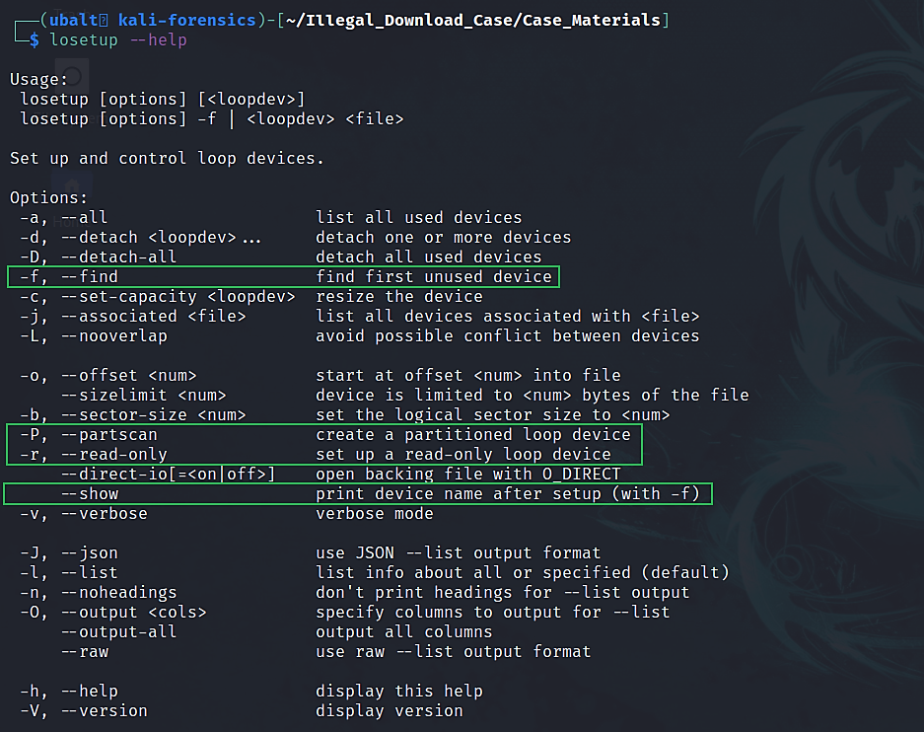
How to get help for losetup.

Slide 9
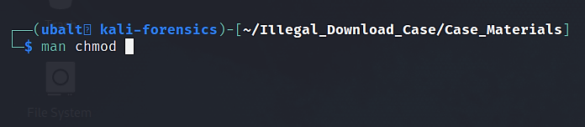

How to get help for chmod.

Slide 10
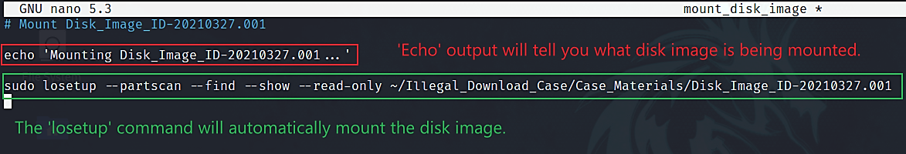
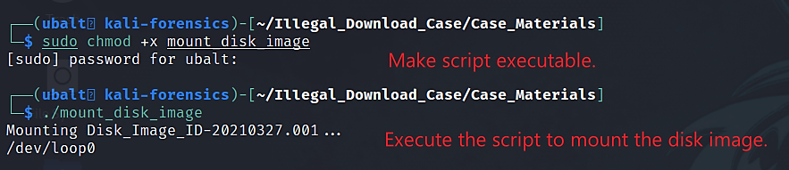
Mount the disk image.

Slide 11
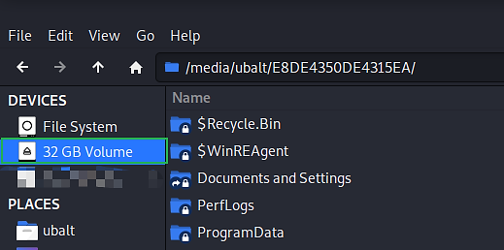
Mount the disk image.
Open the file explorer => Click on the mounted image. You may have to type in your password:
Notice that you have mounted Kamryn’s 2nd partition. In this screenshot, the hex number following /media/ubalt is the 2nd partition’s volume serial number. This is the same hex number that we saw from fdisk’s output.
*Replace ubalt with your username.

Slide 12
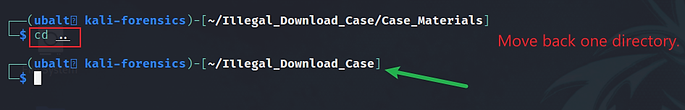
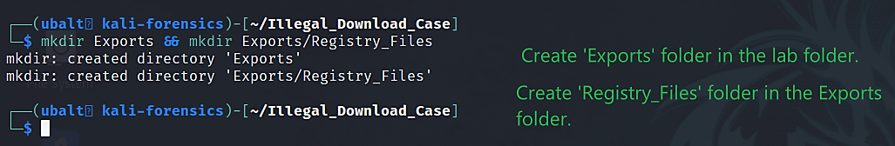
Create folder(s) to store exported files.

Slide 13
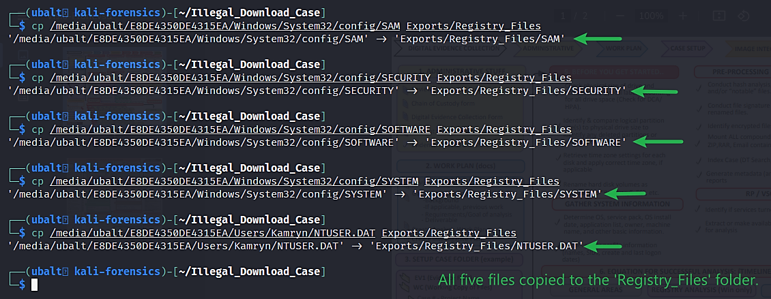
Copy Registry files from the mounted disk image to your ‘Registry Files’ folder.

Slide 14
How to use Regripper.
Regripper parses the registry files using plugins. These plugins determine the information collected by Regripper.
Use ‘rip.pl –l’ for a complete list of all plugins (recommended to output to a text file or use ‘| more’ since the output is long).
The plugins will tell Regripper where to look for information
therefore, you will not have to manually look through the registry hives.
Command –
rip.pl –r <registry hive> -p <plugin>
Note: For the registry hive, you must input the file path of the registry hive. This only applies if you are not in the same directory where you placed the registry hives.

Slide 15
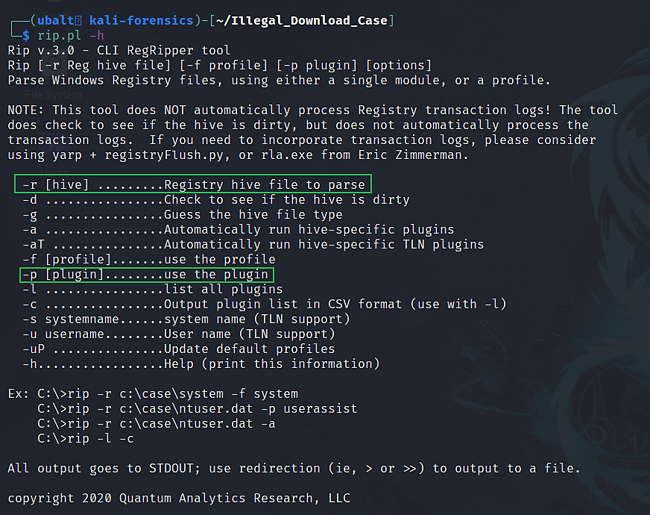
How to get help for Regripper.

Slide 16
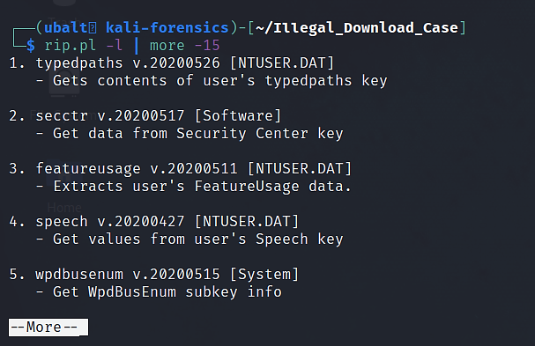
List plugins for Regripper.

Slide 17
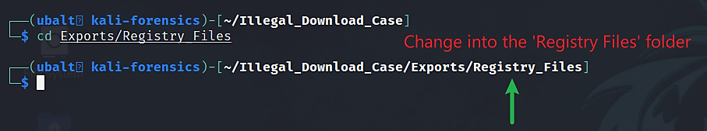
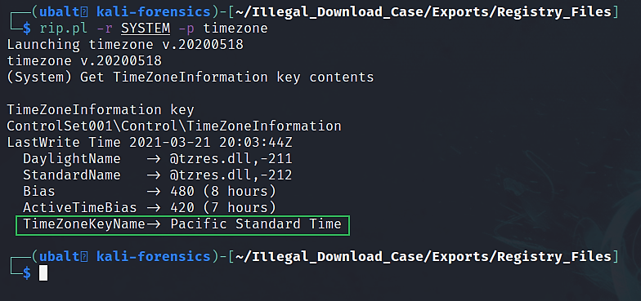
Use Regripper to see what the system’s timezone is.

Slide 18
How to read the timezone plugin’s output.
Pacific Standard Time (PST) is 8 hours behind UTC and 1 hour behind Pacific Daylight Time (PDT).
On Regripper’s output where it says ‘Bias’ and ‘ActiveTimeBias’:
Bias -> 480 minutes (8 hours) from UTC time (no Daylight Savings = Pacific Standard Time)
ActiveTimeBias -> 420 minutes (7 hours) from UTC Time (Daylight Savings = Pacific Daylight Time)
This timezone is used in the western United States. This disk image was acquired from a computer in Maryland. Therefore, this system’s timezone was not changed to the right setting by the suspect.
Since it was Daylight Savings Time when this image was acquired, we must assume that timestamps from the system could be in PDT.

Slide 19
What is UTC? (We use UTC in labs)
UTC is Coordinated Universal Time.
It is the universal standard for the world’s time.
Some comparisons:
UTC is 4 hours ahead of EDT and 5 hours ahead of EST. (Current timezone for University of Baltimore)
UTC is 7 hours ahead of PDT and 8 hours ahead of PST. (Timezone of Kamryn’s system)
Useful websites –
https://www.utctime.net/
https://www.timeanddate.com/worldclock/timezone/utc

Slide 20
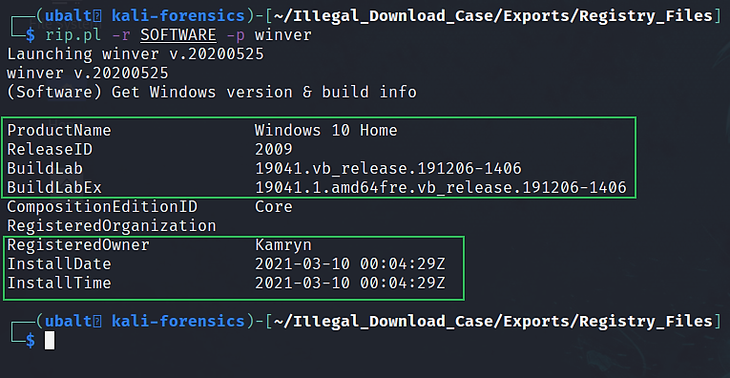
Use Regripper to see what operating system was installed on the system.

Slide 21
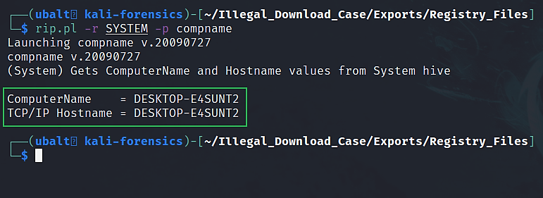
Use Regripper to get the system’s name.

Slide 22
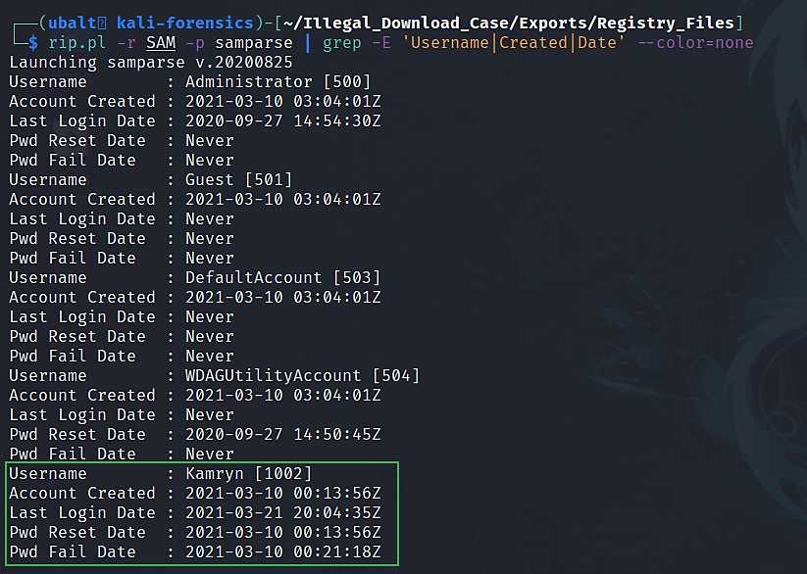
Use Regripper to see the user accounts on the system.

Slide 23
Explanation
Regripper’s results gives us this information:
User Account | Kamryn
User Account Creation Date | 03/10/2021 00:13:56
User Account Last Login Date | 03/21/2021 20:04:35
Operating System (OS) | Windows 10 Home
OS Build | 19041
System Name | DESKTOP-E4SUNT2
System Owner | Kamryn
System Timezone | Pacific Standard Time (PST)
System Install Date & Time | 03/10/2021 00:04:29

Slide 24
Alternate Ways of Answering the Question
Hivexsh can be used to manually analyze the Registry files.
You should do this as well despite Regripper analyzing them for us. Not only will you know where to find this information, but you can validate Regripper’s results.
Another way of getting the Registry files is using icat tool.
You can use fls tool – which is demonstrated in question #5 – to get the inodes for each Registry file. Then, you would use icat to obtain the file.

Slide 25
3. What was the last account to logon?
Tools Used:
Regripper
Lastloggedon plugin
Hivexsh (optional)

Slide 26
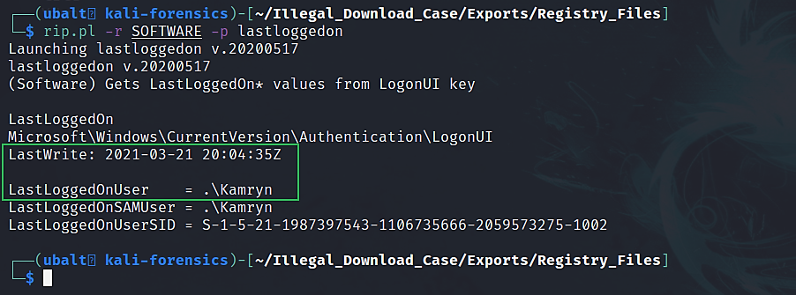
Use Regripper to discover the user who most recently logged on and when that logon took place.

Slide 27
Explanation
This answer was also on question #2 when we looked up the user accounts on the system.
‘Kamryn’ was the last user to logon on 03/21/2021 at 20:04:35Z.

Slide 28
Alternate Ways of Answering the Question
Hivexsh can be used to manually analyze the Registry files.
You should do this as well despite Regripper analyzing them for us. Not only will you know where to find this information, but you can validate Regripper’s results.

Slide 29
4. When was the computer shut down?
Tools Used:
Regripper
Shutdown plugin
Hivexsh (optional)

Slide 30
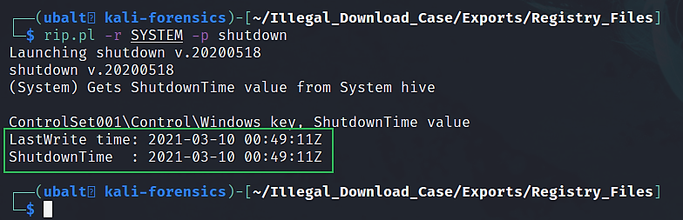
Use Regripper to find out when the most recent shutdown took place.

Slide 31
Explanation
The last shutdown was on 3/10/2021 at 04:49:11.
This could mean that the person who had control of the system did not shut the computer down for a while. The system could have been in sleep or hibernation.
Windows event logs should be able to verify this information and give us more details on the user’s login activities.

Slide 32
Alternate Ways of Answering the Question
Hivexsh can be used to manually analyze the Registry files.
You should do this as well despite Regripper analyzing them for us. Not only will you know where to find this information, but you can validate Regripper’s results.

Slide 33
5. Generate a directory listing of the files on the pc. Can you identify any applications and/or files of interest?
Tools Used:
fls
Regripper
Recentdocs plugin
JLECmd (optional)
Tree (optional)

Slide 34
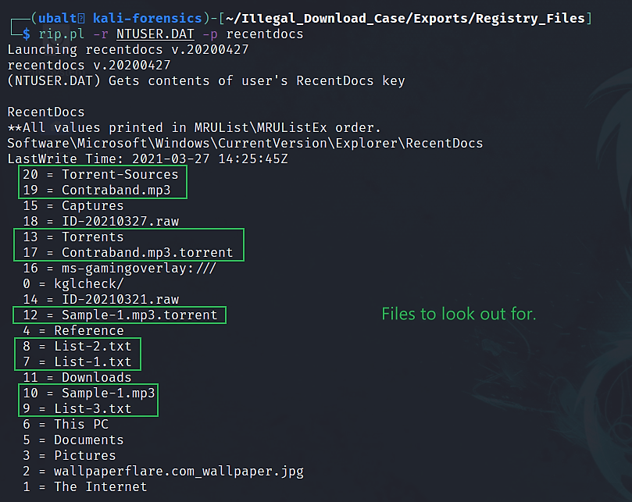
Use Regripper to see what the user recently opened.

Slide 35
How to use fls
fls can be used to list the directories and/or files on a given partition.
The tool requires that you include the offset of the partition you want the tool to be used on. This tells the tool where to look for information.
We want to get the directories and files from the 2nd partition. Recall that when we used fdisk to print the partition table, the 2nd partition starts at 104448.
Fls requires that we include ‘-o 104448’ in our commands so that it knows to look in the 2nd partition. If you do not supply this information, the tool will not know which partition to look in, and it will not work.

Slide 36
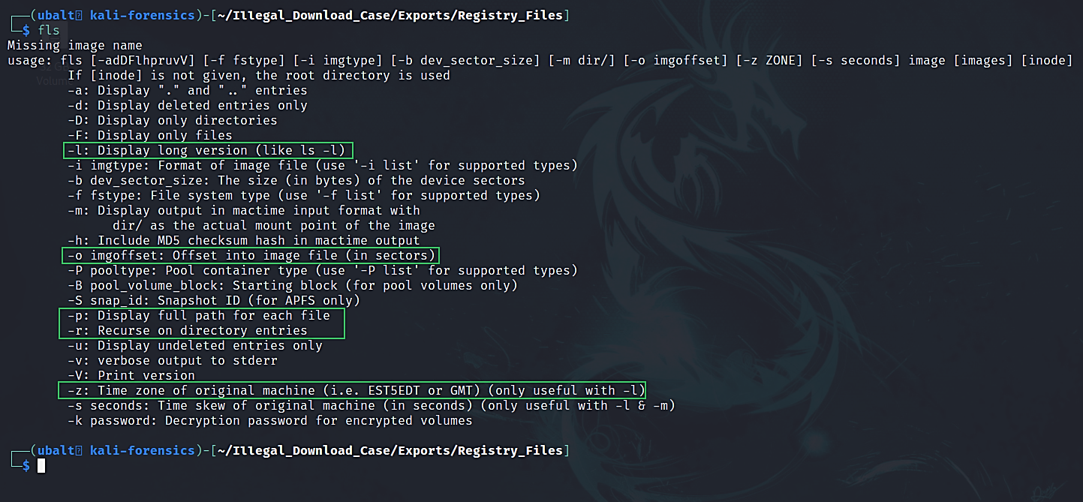
How to get help for fls.

Slide 37
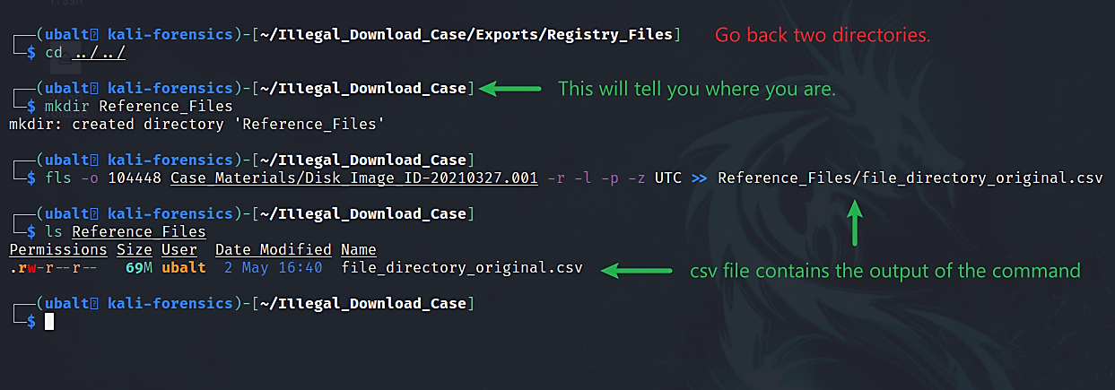
Use fls to generate a directory listing.

Slide 38
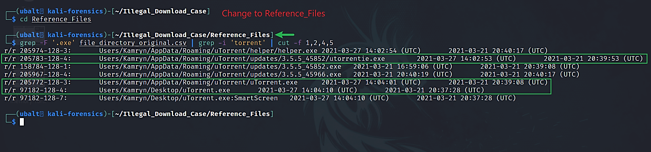
Use grep to search for torrent applications.
Notes:
https://wiki.sleuthkit.org/index.php?title=Fls

Slide 39
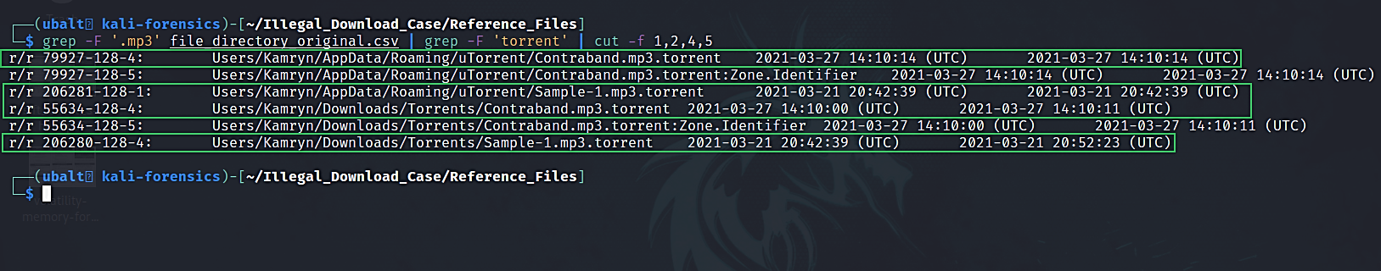
Use grep to search for torrent files.

Slide 40
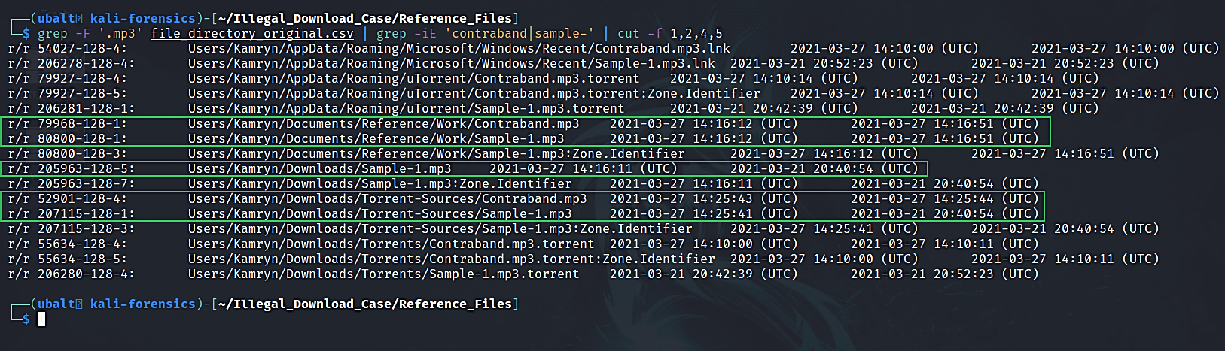
Use grep to search for .mp3 files.

Slide 41
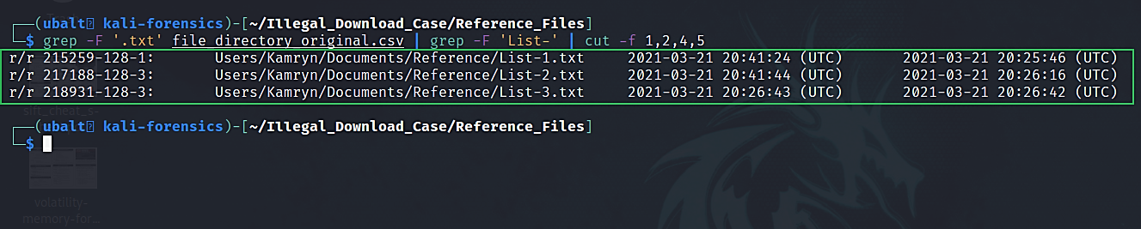
Use grep to search for text files.

Slide 42
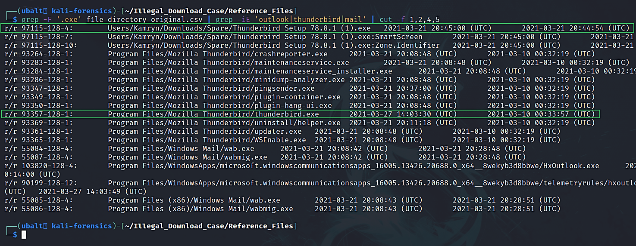
Use grep to search for email client.

Slide 43
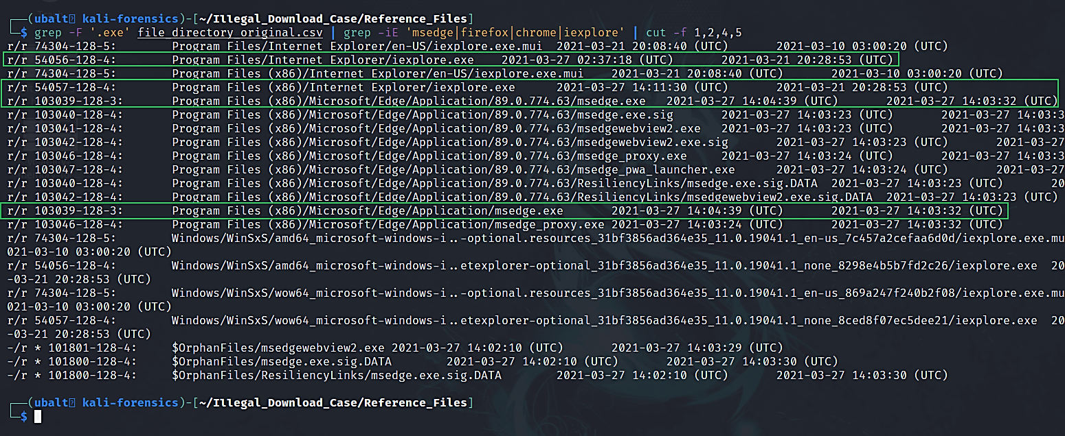
Use grep to search for web browsers.

Slide 44
Look for directories/files seen from Regripper’s recentdocs plugin.
The same process can be done for any other files that catches your eye.
From this, the files/programs of interest are:
utorrentie.exe (uTorrent setup executable)
uTorrent.exe (uTorrent executable)
Contraband.mp3.torrent
Contraband.mp3 and its link file
Sample-1.mp3.torrent
Sample-1.mp3 and its link file
List-(1,2,3).txt
Mozilla Thunderbird
Microsoft Edge
Internet Explorer

Slide 45
Explanation
Using Regripper’s recentdocs plugin, we were able to find the files the user recently accessed. Fortunately, these were files relevant to the investigation.
Using fls, we searched for the files we saw from Regripper’s recentdocs output.
We found a torrent application, torrent files, mp3 files with similar names to the torrents, an email client, and web browsers. We also have timestamps related to when the user last accessed and changed the files.
The timestamps will help us narrow our investigation to specific time periods. This is very useful for timeline analysis. We will create one in the next demonstration.

Slide 46
What the discovered torrent files mean for the investigation.
Kamryn has ‘Contraband.mp3.torrent’ and ‘Contraband.mp3’.
‘Contraband.mp3’ could have been downloaded from the torrent file, or Kamryn already had it and created a torrent file out of it.
The same applies for ‘Sample-1.mp3.torrent’ and ‘Sample-1.mp3’.
When we acquire more information, we could determine how Kamryn acquired these files. For now, we know that Kamryn has the files the company is looking for and could be torrenting them.

Slide 47
(Optional) Fix the output from fls
By default, fls does not label the columns. If you want each column labeled:
Use the echo command to create column names
Use the cat command to output the contents of the file directory text file
Combine these into one file
First, we will use the echo command to place the column names into a text file, file_directory_modified.txt.
Then, we will use the cat command to place the entries from the file_directory_original.txt file into file_directory_modified.txt.
Important echo flag –
-e: allows echo to recognize backslash characters
\t is one of these backslash characters. \t inserts a horizontal tab space.
Use the command ‘man echo’ to view all possible options.

Slide 48
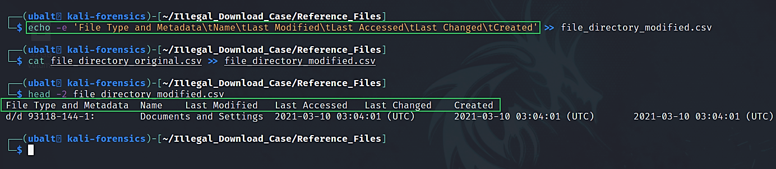
Use echo to create column titles, then cat to output the contents of our recently created text file. Redirect output to a new text file.

Slide 49
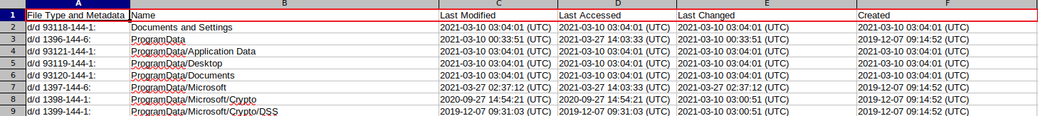
Here is how it would look in a GUI application.

Slide 50
Alternate Ways of Answering the Question
Tree can also be used to generate a file directory; however, the ouput is in a tree-like format. Also, you would point the tool towards the ‘/media/$USER/<volume serial number>’ directory instead of the disk image file.
Unlike fls, Tree does not provide the inode numbers for the files.
An alternative for using Regripper’s recentdocs plugin is a tool that looks at the jump lists. JLECmd is a tool that can do this.
See: ‘/Users/Kamryn/AppData/Roaming/Microsoft/Windows/Recent/’

Slide 51
Next Presentation
MFT Timeline

